Slide 1



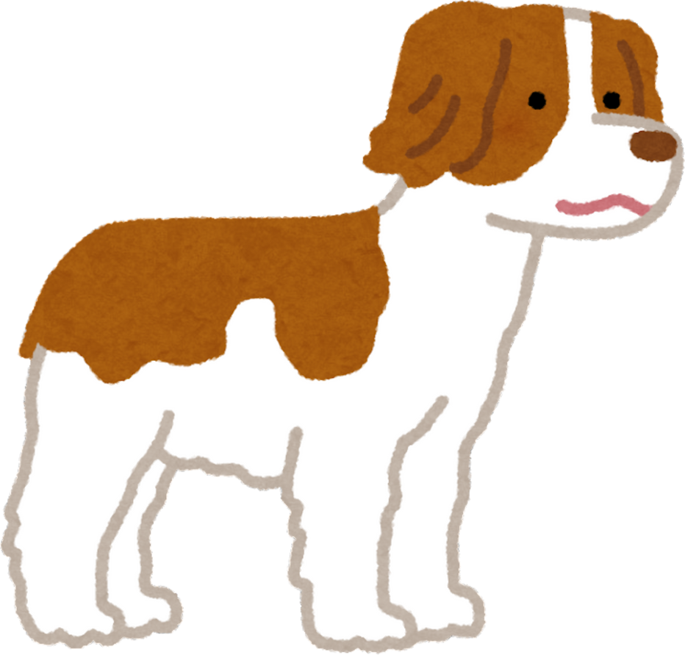
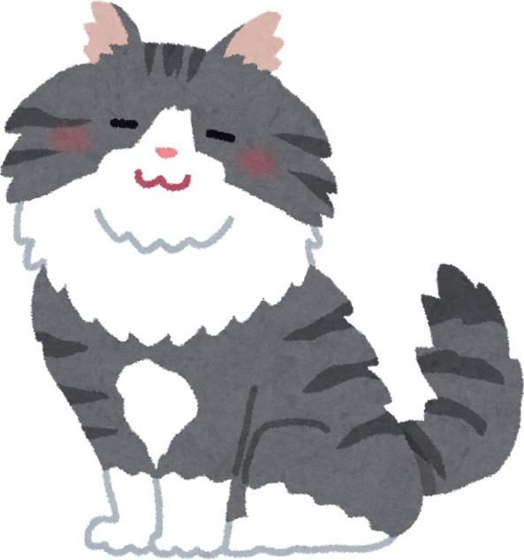
P
Y
E
D
T
D
B
U
A Complete Pet Care Ecosystem Adoption • Nutrition • Healthcare

Slide 2
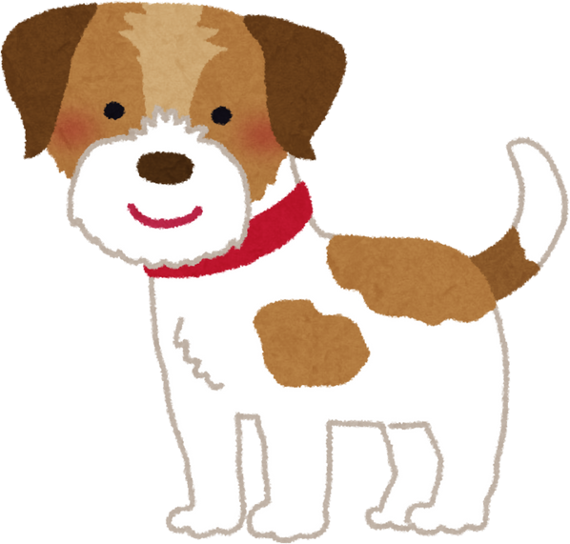
DESIGN BRIEF
Pet Buddy is a unified pet care mobile app focused on pet adoption, food ordering, and veterinary appointment booking.
The goal is to build a friendly, trustworthy, and seamless experience for new and existing pet owners.
Objectives:
Help users adopt verified pets safely
Provide easy ordering of pet food & essentials Enable quick vet appointment booking Deliver a warm, pet-friendly user interface
Design Challenges:
Combining three major services without overwhelming users Ensuring trust and verification in adoption
Maintaining a consistent visual and interaction design

Slide 3
DESIGN PROCESS
A complete user-centered design approach:
Design Thinking Steps:
1. Empathize – Research, Interviews
Define
Ideate
Prototype
Test
Problem Statements
Brainstorming Solutions
Wireframes & UI
User feedback
This ensured the solution stayed aligned with user expectations.

Slide 4



STAKEHOLDER MAPPING
Primary Stakeholders Pet adopters Existing pet owners Veterinarians
Pet food suppliers
Secondary Stakeholders Animal shelters / NGOs Pet grooming & training centers
Delivery partners App administrators
Influencers
Animal welfare organizations Government regulations
Pet communities

Slide 5



USER PERSONA
👤 Persona 1: New Pet Adopter (Age 21–30)
Goals: Find a healthy, verified pet; understand care basics
Pain Points: Unverified sources, lack of trust
👤 Persona 2: Working Professional Pet Owner (Age 25–40)
Goals: Quick vet booking, easy food reordering
Pain Points: Time constraints, emergency situations
👤 Persona 3: First-Time Pet Parent (Age 18–28)
Goals: Guidance, reliable products, easy navigation
Pain Points: Overwhelming information, confusing platforms

Slide 6

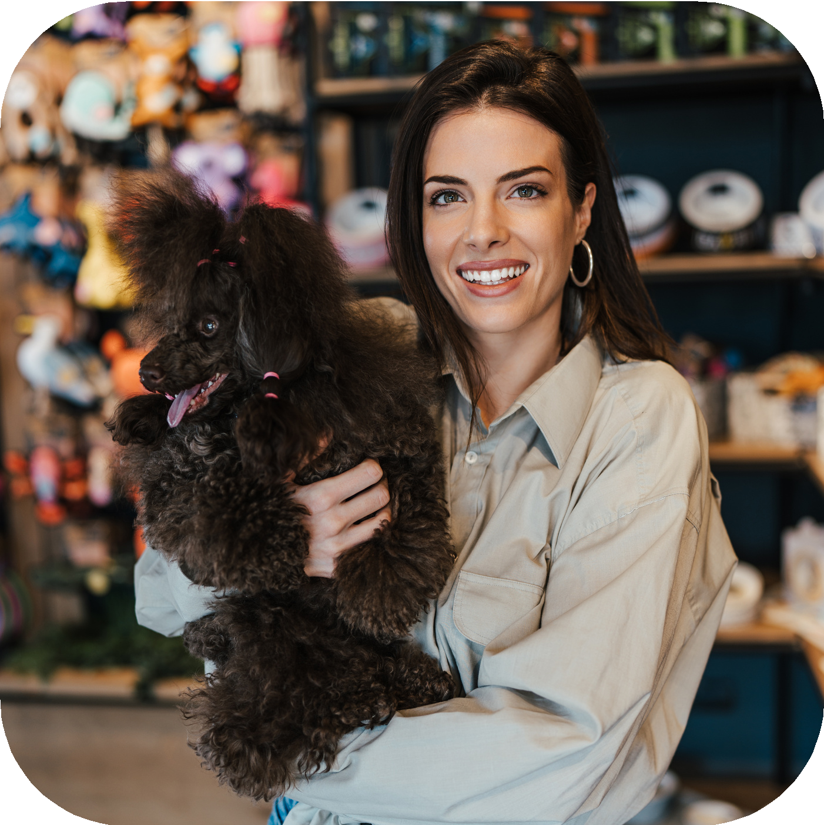
USER INTERVIEWS (Research)
Methods
1:1 interviews
Online questionnaires Observations of pet owners
Key Findings
72% prefer one app for all services
Pet adoption must feel safe and verified Users need fast vet access
Food shopping must be quick and reliable Simple navigation increases trust
These insights guided the design direction.

Slide 7

EMPATHY MAPPING
SAYS
“I want to adopt from a trusted source.”
“Booking a vet takes too much time.”
“I want everything in one app.”
DOES
Checks multiple apps Searches for reviews Calls vets manually
THINKS
Is this pet healthy?
Are these vets real and certified?
Is the product good quality?
FEELS
Overwhelmed Concerned for pet safety Needs reassurance

Slide 8
DEFINE STAGE
(Problem Statements)
Problem 1:
Users struggle to find verified and trustworthy pet adoption sources.
Problem 2:
Ordering pet food from multiple platforms is time-consuming and inconsistent.
Problem 3:
Vet appointment booking lacks convenience and transparency.
Problem 4:
Users need a unified app for seamless pet care.

Slide 9
CUSTOMER JOURNEY MAPPING
Typical Pet Owner Journey
Stage: Awareness → Consideration → Decision → Adoption → Care
Touchpoints & Pain Points:
Searching for pets → Trust issues Buying food → Low availability
Finding vets → Delays, long waiting times Managing health → No centralized record
Opportunities:
Provide verified adoption listings Simplify food ordering
Offer instant vet booking
Maintain pet health records

Slide 10
AFFINITY MAPPING
Cluster 1: Trust & Verification
Verified shelters Verified vets Health records
Cluster 2: Convenience & Speed
Quick booking Easy search
One-tap reordering
Cluster 3: Emotional Connection
Pet-friendly visuals Personalization Warm colors
Cluster 4: Navigation Simplicity
Clean home dashboard Clear categories Minimal steps

Slide 11
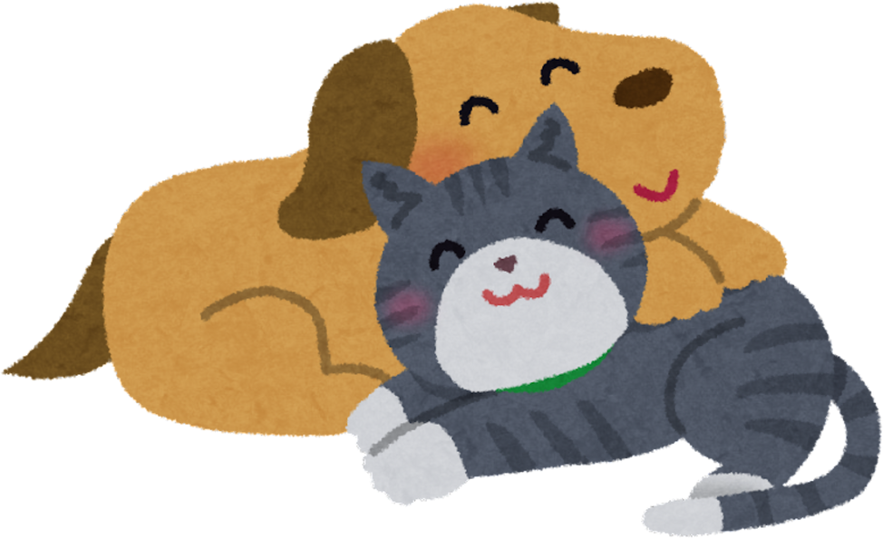
IDEATION STAGE
Brainstormed Solutions Pet adoption dashboard Pet profile with history & vaccination status
Food store with categories Vet listing with availability Appointment calendar
Pet health records Order history
Selected Solutions
We filtered ideas using: User value Feasibility
Impact on experience Technical complexity

Slide 12
Prototype (Screen Shots)

Slide 13

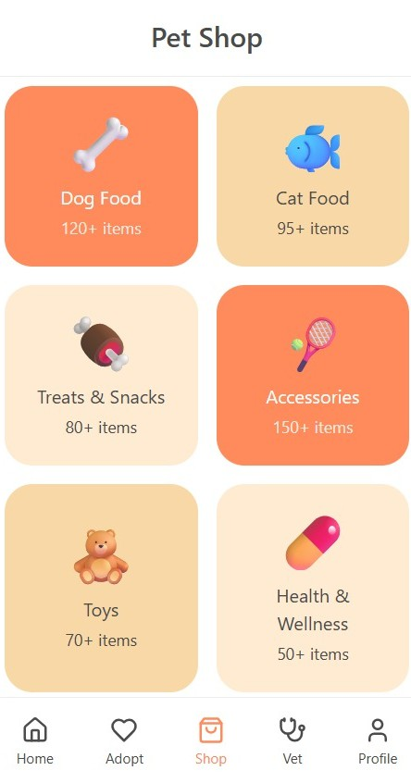
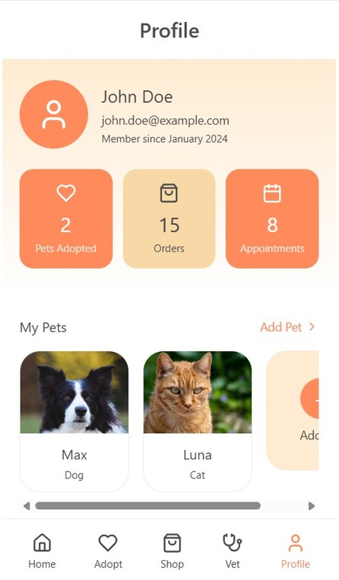
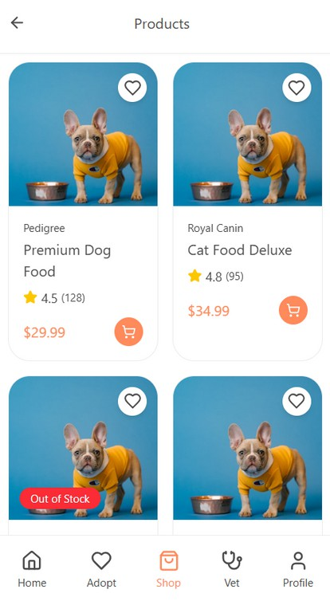
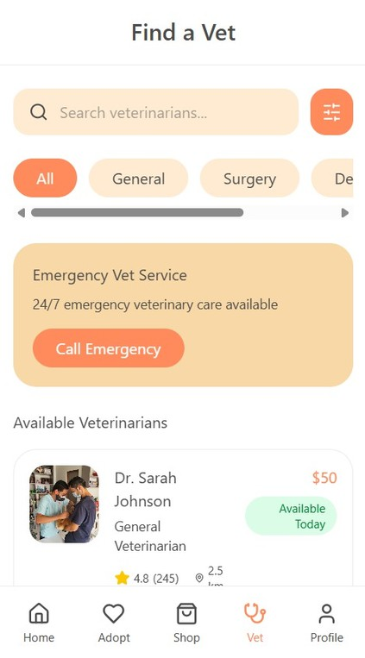

Slide 14
